Slide 1


WeAllocate!
The Smart Resource Optimizer
Group 3
Daniyal Khan
Umar Khan Bilal Naseer
David Cardenas

Slide 2
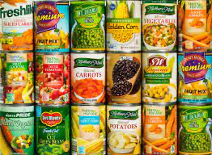
Purpose
IMAN is a Chicago based Food bank and Community Center
Challenges Addressed for IMAN
Unpredictable demand
Perishable item wastage
Maximizing resource impact
Pioneering a movement by Revolutionizing charitable food distribution systems
Notes:
The main focus is on the final system and object designs.
UML ( class ) diagrams are encouraged.
Start with just enough background to remind us of the context.
Cover requirements / design goals only to the extent needed for the audience to appreciate the design.
Don't waste time on account creation, setup, or login. Mention them in passing only if they are really important.

Slide 3
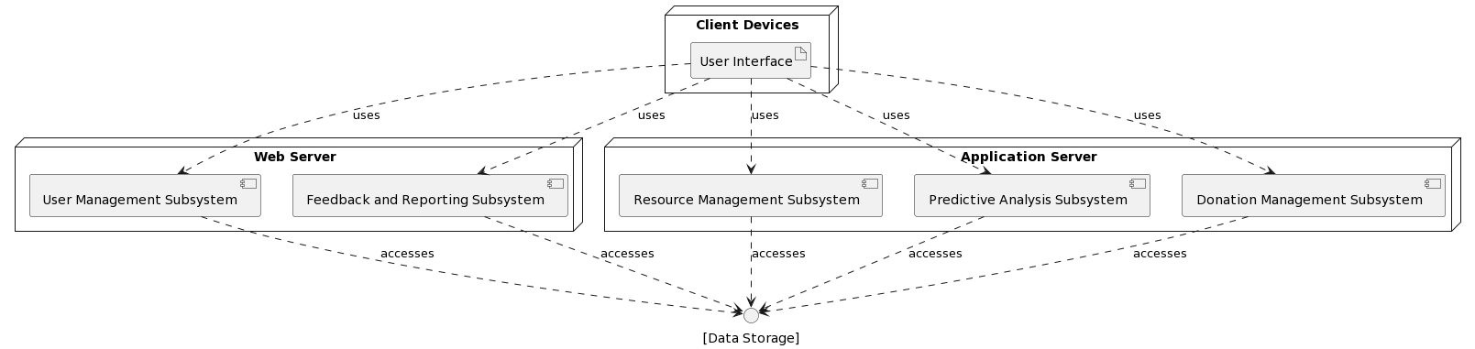
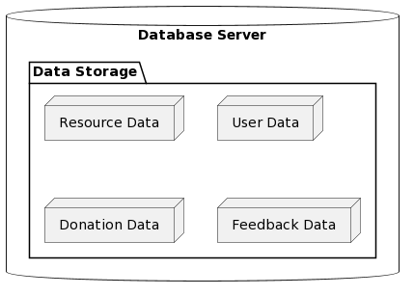
System Overview

Slide 4
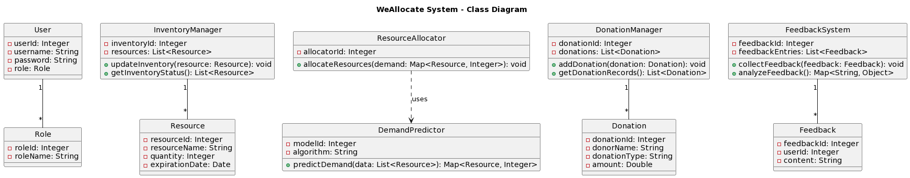
General UML

Slide 5
Existing System Proposed Upgrades
Manual Resource Allocation
Relies on human judgment and experience.
Uses spreadsheets or simple databases.
Time-consuming, error-prone, and inflexible.
Inventory Management
Physical inventory checks with basic data entry.
Lacks real-time updates and predictive capabilities.
Beneficiary Interaction and Feedback
Gathers direct feedback during distribution.
Feedback not systematically used in decision-making.
Donation Management
Tracks donations manually or with basic digital tools.
Poor integration with resource allocation processes.
Decision Making
Based on staff experiences and historical data.
Reactive approach, lacks predictive analytics.
Enhanced Resource Allocation:
Automates and optimizes resource allocation using machine learning.
Reduces reliance on human judgment, minimizing errors and improving efficiency.
Advanced Inventory Management:
Integrates real-time data tracking and updates.
Employs predictive analytics to anticipate demand and manage supply more effectively.
Systematic Beneficiary Interaction and Feedback:
Streamlines feedback collection during distribution into the decision-making process.
Utilizes beneficiary feedback to refine resource allocation and distribution strategies.
Improved Donation Management:
Automates tracking of both monetary and resource donations.
Enhances integration between donation management and resource allocation, optimizing resource utilization.
Data-Driven Decision Making:
Leverages historical data and current trends through machine learning for proactive decision-making.
Reduces reliance on staff experience alone, adding a layer of predictive analytics for more accurate and efficient decisions.

Slide 6
Integration and Workflow
Demand Prediction:
Feature Engineering: Relevant features or factors affecting demand are extracted or engineered. These features could include seasonality, holidays, economic indicators, and demographic data.
Machine Learning Models: Various machine learning algorithms are employed, such as time series forecasting models (e.g., ARIMA or Prophet) or more advanced techniques like neural networks, to predict future demand accurately.
Real-time Data Integration: The module continually integrates real-time data, such as current events, weather conditions, and social factors, to fine-tune the demand predictions.
Demand Forecasting: Based on the ML models' predictions, the module generates demand forecasts for various resources, including types of food items, quantities, and distribution timelines.
Notes:
Daniyal

Slide 7
Integration and Workflow
Resource Optimization:
Demand-Resource Matching: The ML module matches predicted demand with available resources based on type, quantity, shelf life, and stock levels.
Efficient Allocation: Using optimization algorithms, it allocates resources for maximum impact, reducing waste.
Dynamic Inventory Management: The module updates inventory based on demand predictions, minimizing surplus and preventing resource expiration.
Minimizing Waste: By accurate demand prediction and allocation, it minimizes food waste, optimizing resource usage.
Feedback-Driven Improvement: Incorporates actual distribution feedback to refine predictions and allocation strategies over time.
Notes:
Daniyal

Slide 8
Key Acceptance tests
ML(Machine Learning)
Test the system's ability to train on historical data and make predictions for future demands.
Inventory data management - CRUD Operations
Test the system's ability to add, update, and delete inventory items.
Validate the system's response to discrepancies in inventory data.
Donation tracking
Test the system's ability to capture real-time donation details for both monetary and in-kind contributions.
Validate the generation of acknowledgment receipts and donation reports.
Portal Feedback - User testing
All data entries and feedback submissions in the portal, including comments, ratings, and details, shall be accurate and up-to-date.

Slide 9
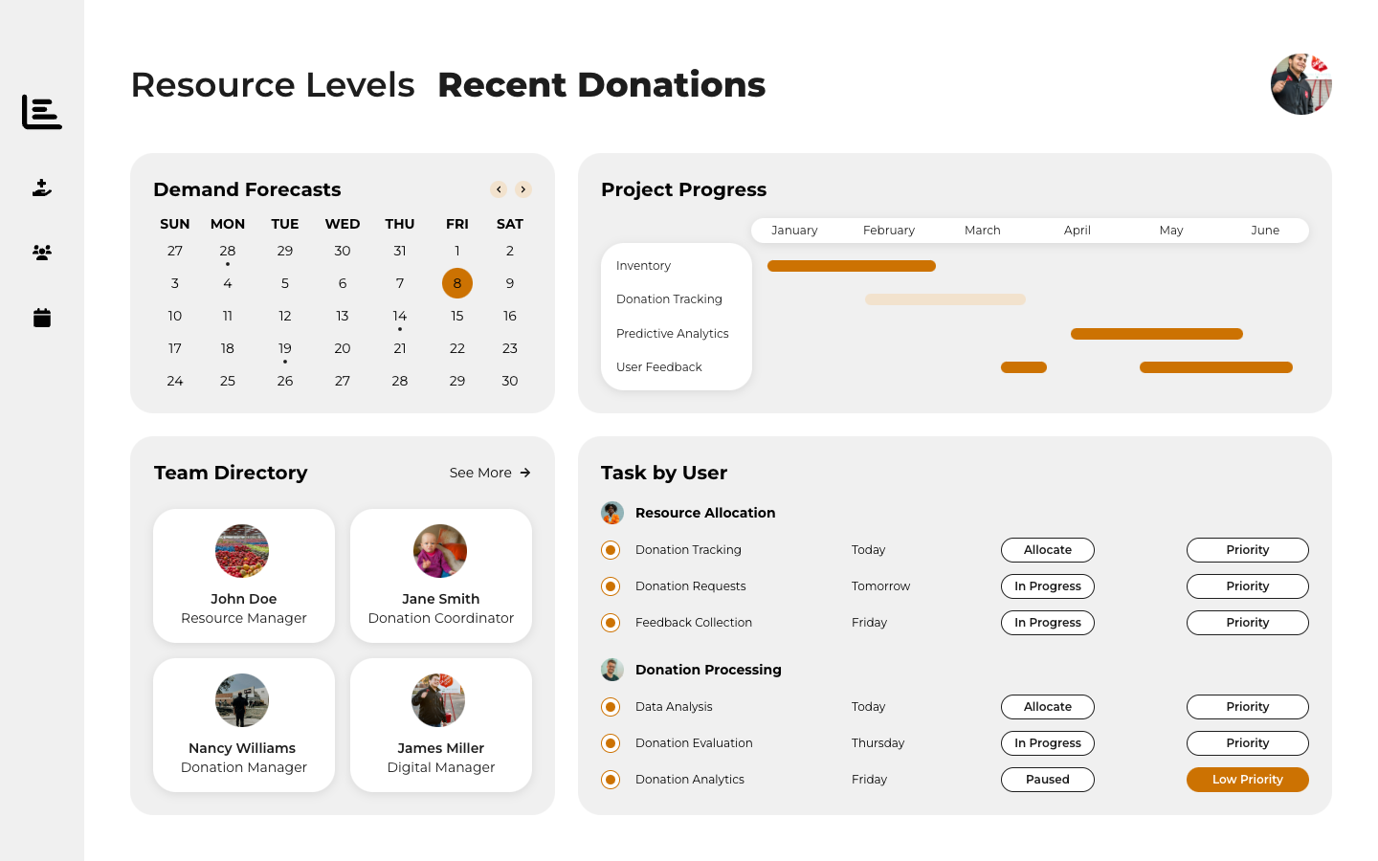
UI/UX

Slide 10
References
References / Bibliography
1. Catania, Patrick J., and Nancy Keefer. “The Marketplace.” Amazon, Board of Trade, 1987, [link](aws.amazon.com/marketplace/solutions/infrastructure-software).
2. “Food Ecosystems.” Inner-City Muslim Action Network, [link](www.imancentral.org/chicago/organizing-advocacy/food-ecosystems/). Accessed 25 Nov. 2023.
3. “Food Pantry Helper.” Food Pantry Helper - Food Pantry Helper, [link](www.foodpantryhelper.com/). Accessed 25 Nov. 2023.
4. Google, Google, [link](cloud.google.com/?utm_source=google&utm_medium=cpc&utm_campaign=na-US-
146
all-en-dr-bkws-all-all-trial-e-dr-1605212&utm_content=text-ad-none-any-DEV_c- CRE_665665924735-ADGP_Hybrid%2B%7C%2BBKWS%2B- %2BMIX%2B%7C%2BTxt_Google%2BCloud%2BGeneral- KWID_43700077212109151-kwd-13487215878&utm_term=KW_google+cloud+services- ST_google%2Bcloud%2Bservices&gad_source=1&gclid=CjwKCAiA04arBhAkEiwAuN OsIoNeRQs3eJLjRImY1wdwly02AVNCQqaM_gb9oCW7WTHOrrWsulRMSxoCbN8QA vD_BwE&gclsrc=aw.ds). Accessed 25 Nov. 2023.
5. “In West Englewood, a New Food Pantry Opens at Corner of Hope and Heartache.” Greater Chicago Food Depository, Greater Chicago Food Depository, 1 Dec. 2022, [link](www.chicagosfoodbank.org/blog/in-west-englewood-a-new-food-pantry-opens-at- corner-of-hope-and-heartache/).
6. “The Number One Food Pantry Solution!” Food Pantry PRO, [link](foodpantrysoftwarepro.com/?gclid=CjwKCAiA04arBhAkEiwAuNOsIuBbQUtrQR NBUrP_pt7QQdrlEKNzKYbpbNT_OzhbdjkhlmRA_3MGxhoCxw8QAvD_BwE). Accessed 25 Nov. 2023.

